Slide 1
To-Do Project

Slide 2
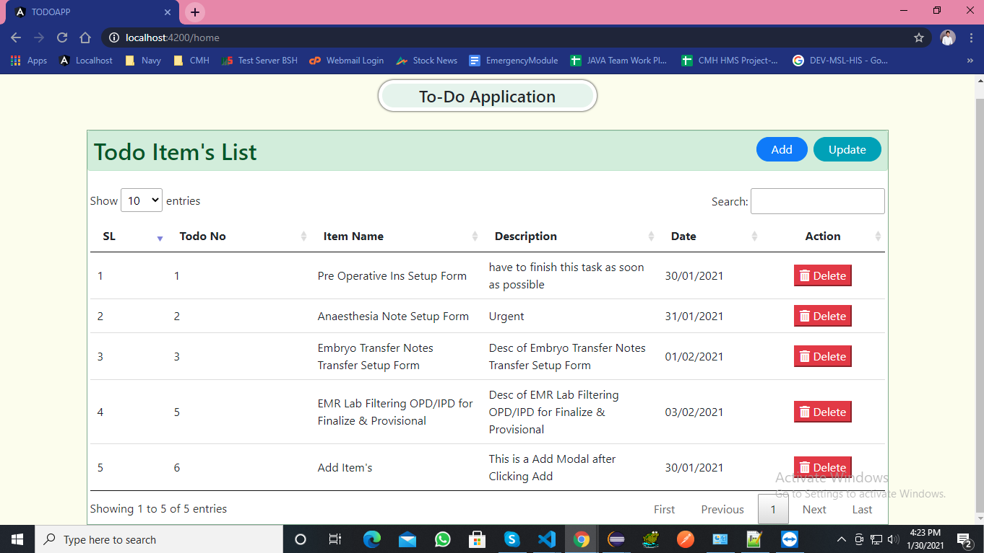
Home Page with Data Table

Slide 3
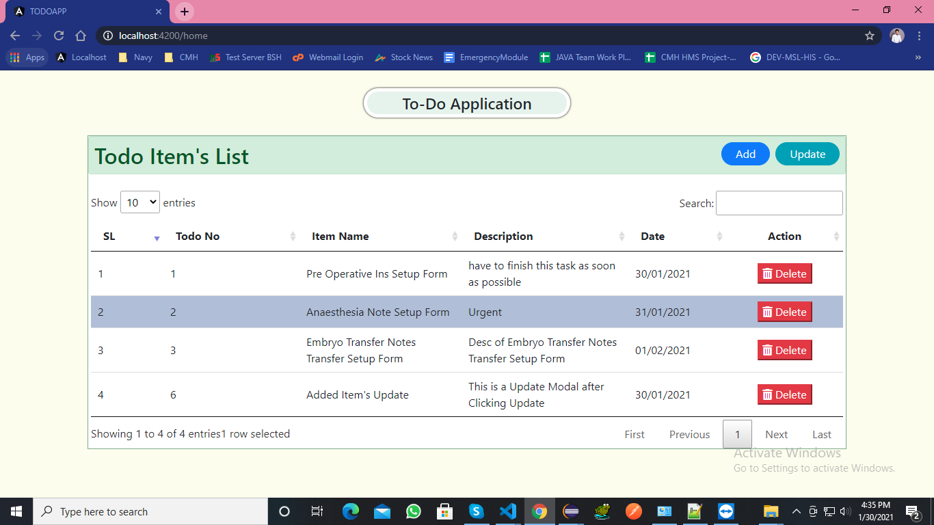
A Row is Selected in Data Table

Slide 4
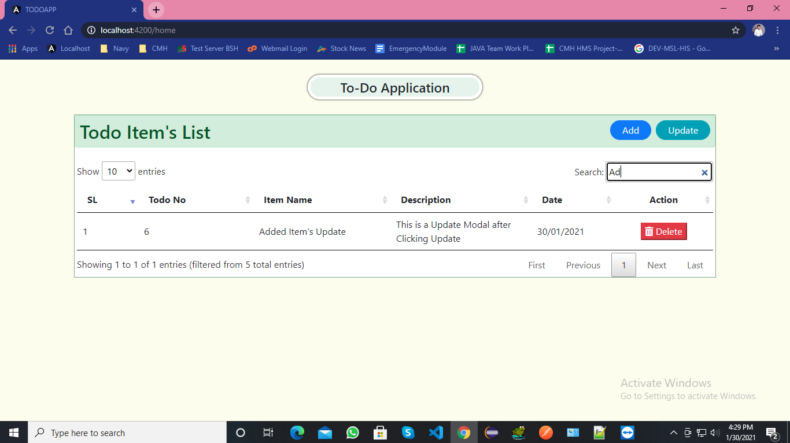
Searching in Data Table

Slide 5
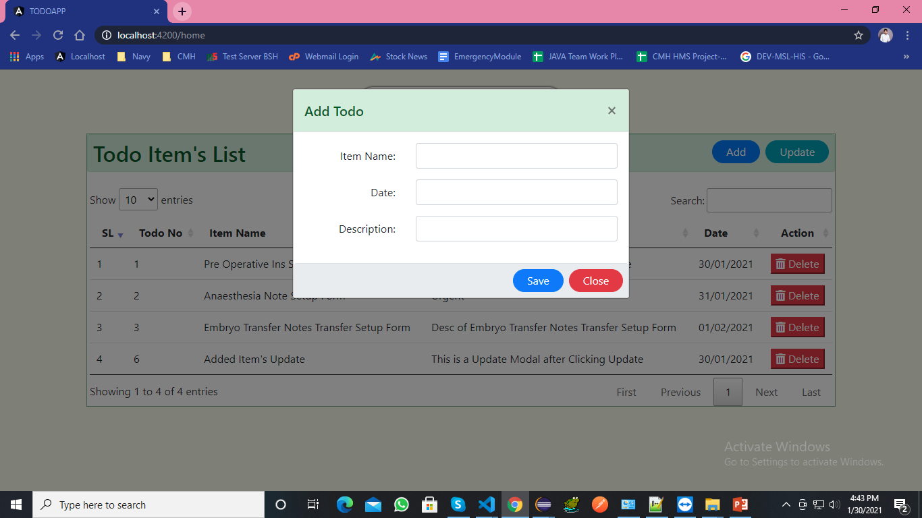
When Click Add Button this Modal Opened

Slide 6
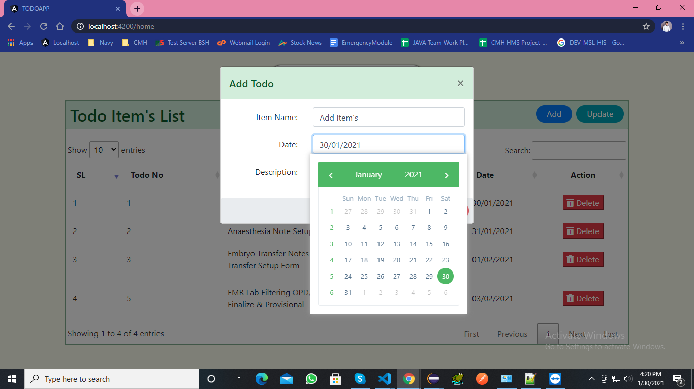
Here Using Date Picker for Selecting Date

Slide 7
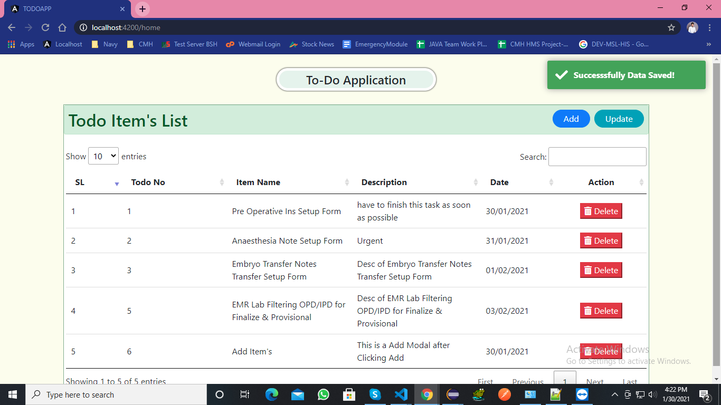
After Clicking Save Modal has hide with Data Table Reload & Success Response Show on toaster

Slide 8
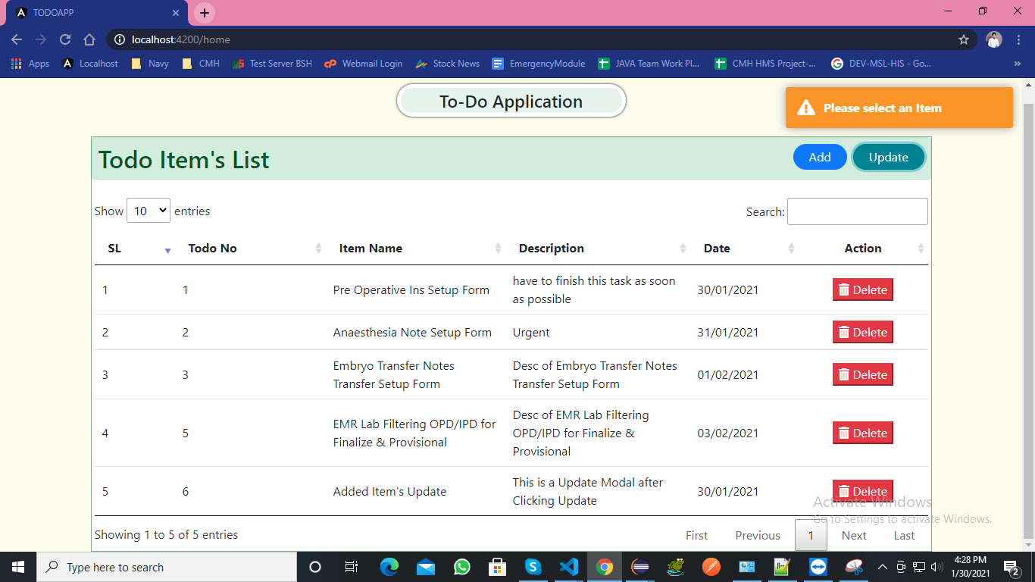
If Clicked to Update Button Without Selecting any Row this message show on toaster

Slide 9
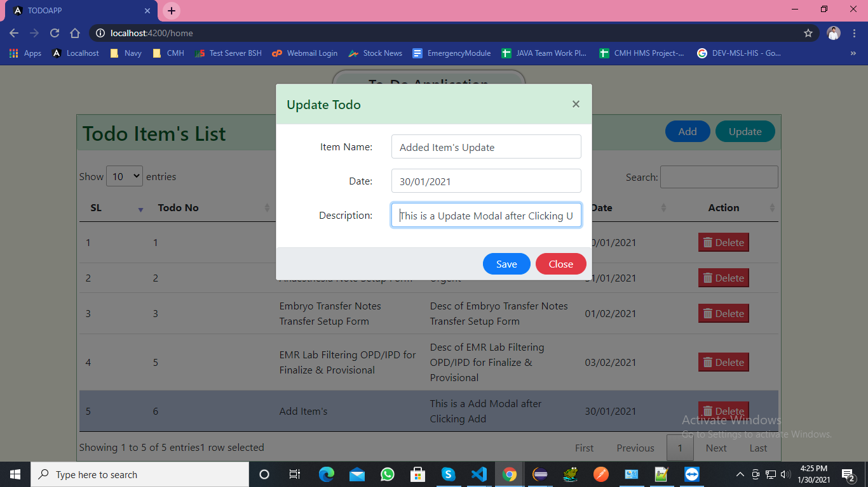
After Selecting a row Click to Update Button this Update Modal Open

Slide 10
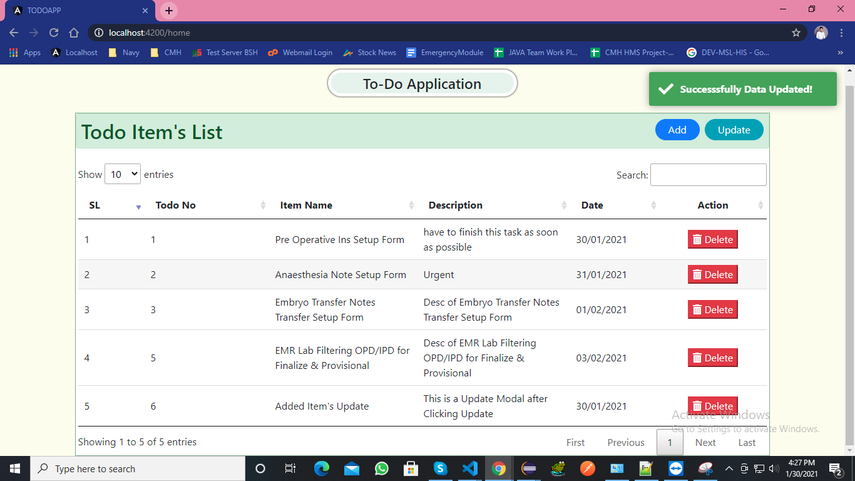
After Updated this Success Response Show on toaster

Slide 11

After Click Delete Button

